Slide 1
Supply Chain Analysis Data Analysis With Sql
I analyzed this project using SQL to provides insight into key performance. It includes a collection of SQL queries designed to extract business insight for quality decision making.

Slide 2
Business objectives / problem statement
To enhance supply decision making by analyzing product performance, customer behavior, supplier reliability, cost efficiency, and logistics flow using available supply chain data.
The goal is to enable us make data driven decision that improve product and sales performance, optimize inventory and stock levels, understand market insight, improve production planning, reduce delay, evaluate supplier effectiveness and optimize logistics, optimize transportation costs and delivery time

Slide 3

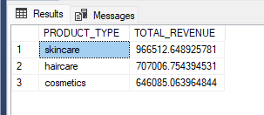
WHAT PRODUCT GENERATED THE HIGHEST REVENUE
SKINCARE PRODUCT GENERATED THE HIGHEST REVENUE WITH A TOTAL OF 966513 APPROXIMATELY

Slide 4

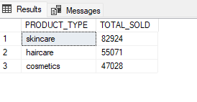
WHAT PRODUCT TYPE HAS THE HIGHEST SALES
A TOTAL OF 82924 SKINCARE PRODUCT WERE SOLD

Slide 5

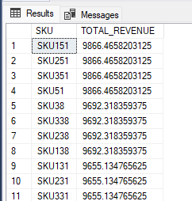
WHAT IS THE TOTAL REVENUE GENERATED BY SKU
SKU 151, 251,351,51 PRODUCT GENERATED THE HIGHEST REVENUE WITH A TOTAL OF 9866 APPROXIMATELY
WHILE SKU 59, 259, 359,159 GENERATED THE LEAST REVENUE WITH A TOTAL OF 1062 RESPECTIVELY

Slide 6

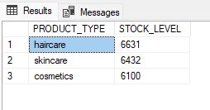
WHAT LEVEL OF STOCK ARE AVAILABLE BY PROCUCT TYPE
HAIRCARE HAS A TOTAL OF 6631 STOCK LEVEL
SKINCARE WITH A TOTAL OF 6432 STOCK LEVEL
COSMETICS WITH A TOTAL OF 6100 STOCK LEVEL
PRODUCT AT THE RISK OF STOCK OUT
OUT OF STOCK PRODUCT ARE: SKU 168, 268,368, 68
PRODUCT AT THE VERY RISK OF STOCK OUT WITH ONLY ONE PRODUCT AVAILABLE:
SKU 34, 234,334,134.

Slide 7

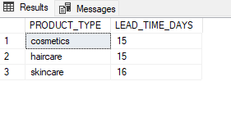
WHAT IS THE AVERAGE LEADTIME FOR PRODUCT
THE LEAD TIME DAYS FOR COSMETICS AND HAIRCARE ARE 15 DAYS
WHILE SKINCARE IS 16 DAYS

Slide 8

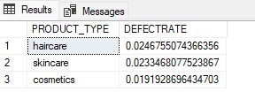
WHICH PRODUCT TYPE HAS THE HIGHEST DEFECT RATE
HAIRCARE HAS THE HIGHEST DEFECT RATE OF ~0.0247
SKINCARE HAS A TOTAL OF 0.0233 DEFECT RATE, WHILE
COSMETICS HAS A TOTAL OF 0.0191 DEFECT RATE

Slide 9

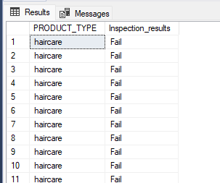
HAIRCARE PRODUCT WITH FAILED ORDER FAILED ORDER
53 HAIRCARE PRODUCT FAILED TO BE DELIVERED

Slide 10

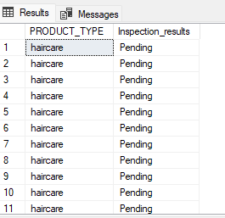
WHICH HAIRCARE PRODUCT HAS A PENDING ORDER
60 HAIRCARE PRODUCT WERE PENDING

Slide 11

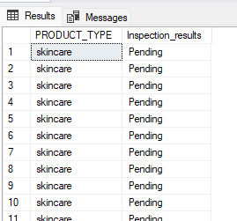
WHICH SKINCARE PRODUCT HAS A PENDING ORDER
64 SKINCARE PRODUCT WERE PENDING

Slide 12

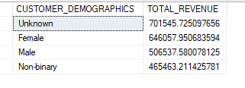
WHICH CUSTOMER DEMOGRAPHICS GENERATED THE HIGHEST REVENUE
UNKNOWN GENERATED THE HIGEST REVENUE 701546
FEMALE GENERATED 646058
MALES GENERATED 506538
NON-BINARY GENERATED 465463

Slide 13

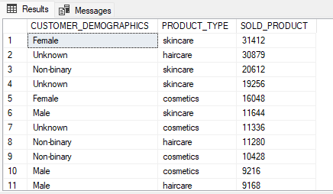
FREQUENTLY PURCHASED PRODUCT BY DEMOGRAPICS
FEMALES PURCHASE SKINCARE MORE AND LESS OF HAIR CARE PRODUCT

Slide 14

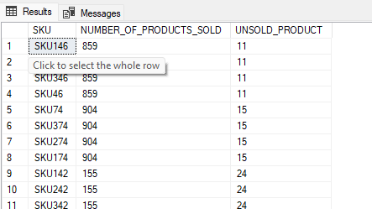
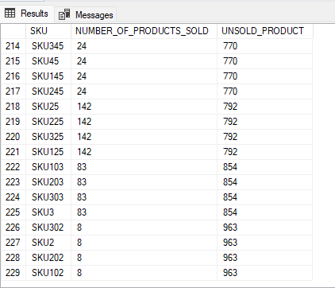
WHAT IS THE VOLUME OF UNSOLD PRODUCT
229 PRODUCT WERE UNSOLD, SKU 302, 2, 202, 102 HAVING 8 PRODUCTS SOLD AND 963 UNSOLD PRODUCT
SKU 146, 246, 346 AND 46 HAVING LESSER UNSOLD PRODUCT: 11 UNSOLD AND 859 GOODS SOLD

Slide 15

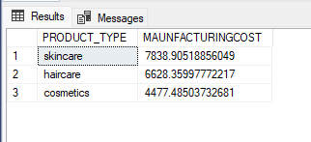
WHAT IS THE AVERAGE MANUFACTURING COST OF PRODUCT
THE AVERAGE MAUNFACTURING COST FOR SKINCARE IS ~ 7839
THE AVERAGE MAUNFACTURING COST FOR HAIRCARE IS ~ 6623
THE AVERAGE MAUNFACTURING COST FOR skincare IS ~ 4477

Slide 16

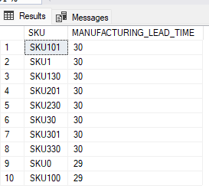
WHICH PRODUCT TYPE HAS THE LONGEST MANUFACTURING LEADTIME
SKU101,1,130,201,230,30,301,330,HAS A LEAD TIME OF 30DAYS
WHILE SKU 0 AND 100 HAS A LEAD TIME OF 29 DAYS

Slide 17

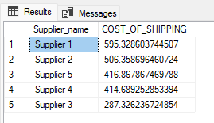
Which supplier incurred the most shipping
SUPPLIER 3 HAS A LOW SHIPPING COST 287.3, FOLLOWED BY
SUPPLIER 4 WITH A SHIPPING COST OF ~ 414.7,
SUPPLIER 5 WITH A SHIPPING COST OF ~ 416.9,
SUPPLIER 2 WITH A SHIPPING COST OF ~ 506.4 WHILE
SUPPLIER 1 HAS BTHE HIGHEST SHIPPING COST OF 595.

Slide 18

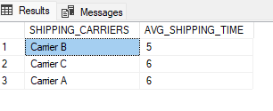
WHAT IS THE AVERAGE SHIPPING TIME BY CARRIER
CARRIER B HAS AN AVERAGE SHIPPING TIME OF 5 TIMES
WHILE
CARRIER B HAS AN AVERAGE SHIPPING OF 6 TIMES

Slide 19

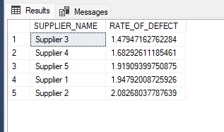
WHICH SUPPLIER HAS THE HIGHEST DEFECT RATE
SUPPLIER 3 HAS THE HIGHEST DEFECT RATE

Slide 20

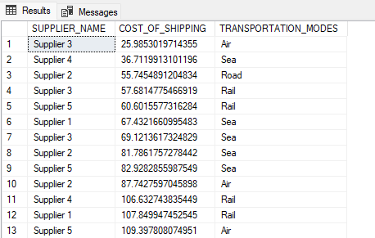
WHO IS THE MOST COST EFFECTIVE SUPPLIER AND WHICH TRANSPORTATION MODE DO THEY USE
SUPPLIER 3 IS THE MOST COST EFFECTIVE AND USES AIR TRANSPORTATION MODE

Slide 21

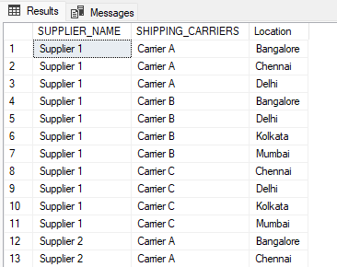
HIGHLIGHT SUPPLIERS BY THERE CARRIERS AND LOCATION

Slide 22
KEY INSIGHT
Skincare emerged as the top-performing category, generating the highest revenue (~₦966,513) and
highest sales volume (82,924 units), signaling strong market demand.
Cosmetics and Haircare also performed well but have slightly lower stock turnover.
Stock availability is highest for Skincare, yet demand still exceeds supply.
Certain SKUs (e.g., 168, 268, 368) are out of stock, and others are at critical low levels, risking fulfillment delays
Skincare has the highest manufacturing cost (~₦7,839) and longest lead times (16 days)
Some SKUs have a large volume of unsold inventory, indicating inefficiencies in demand forecasting
Supplier 3 has the highest defect rate, raising quality concerns.
Supplier 1 incurs the highest shipping cost (~₦595.3), while Supplier 3 is most cost-effective but with high defect rates.
Carrier B has the fastest average shipping time (5 days), making it a reliable option for time-sensitive deliveries.
The ‘Unknown’ category generated the most revenue, suggesting incomplete or inaccurate customer profiling.
Females prefer skincare, while males and non-binary customers show a more balanced interest.

Slide 23
BUSINESS IMPACT
The demand outpaces supply for Skincare and Cosmetics, indicating potential lost sales opportunities and unmet customer demand.
These stockouts can lead to customer dissatisfaction, loss of loyalty, and a potential decrease in revenue.
High production cost and defects affect profit margins and product reliability.
Supplier performance varies widely, affecting cost efficiency, product quality, and delivery timelines.
Better demographic segmentation could improve personalized marketing and product targeting.

Slide 24
RECOMMENDATION
Increase Production for High-Demand Products
Scale up manufacturing of Skincare and Cosmetics to meet demand and avoid missed revenue opportunities.
Review and Optimize Inventory Management
Implement automated reorder systems for low-stock SKUs and perform ABC inventory analysis to prioritize stock.
Improve Supplier Performance
Renegotiate terms or consider replacing Supplier 3 due to high defect rates.
Favor cost-effective suppliers like Supplier 3 only if quality improves, or increase collaboration with Supplier 4 and 5.
Enhance Data Collection on Customer Demographics
Enforce better data validation processes to reduce “Unknown” entries and improve customer segmentation.
Refine Forecasting and Production Planning
Use historical sales and demand trends to prevent overproduction and reduce unsold inventory.
Reduce Lead Time
Optimize the Skincare production process to shorten lead time and improve responsiveness to demand.
Promote High-Moving Products
Bundle high-demand products with slower-moving items to improve inventory turnover.

Slide 25
CONCLUSION
This analysis highlights strong product demand—particularly in skincare
alongside operational inefficiencies in inventory, production, and supplier quality.
By addressing these issues with data-driven decisions, the organization can:
Boost revenue through better stock availability,
Reduce cost and waste by improving supplier and production strategies,
Improve customer satisfaction and retention with faster,
more reliable fulfilment.

